Slide 1
CaUchy’s mean value theorem
done by:
G.BHAVANA REDDY 22H51A0587
G.SOWMYA 22H51A0588
P.HEMANTH SAI 22H51A0589

Slide 2
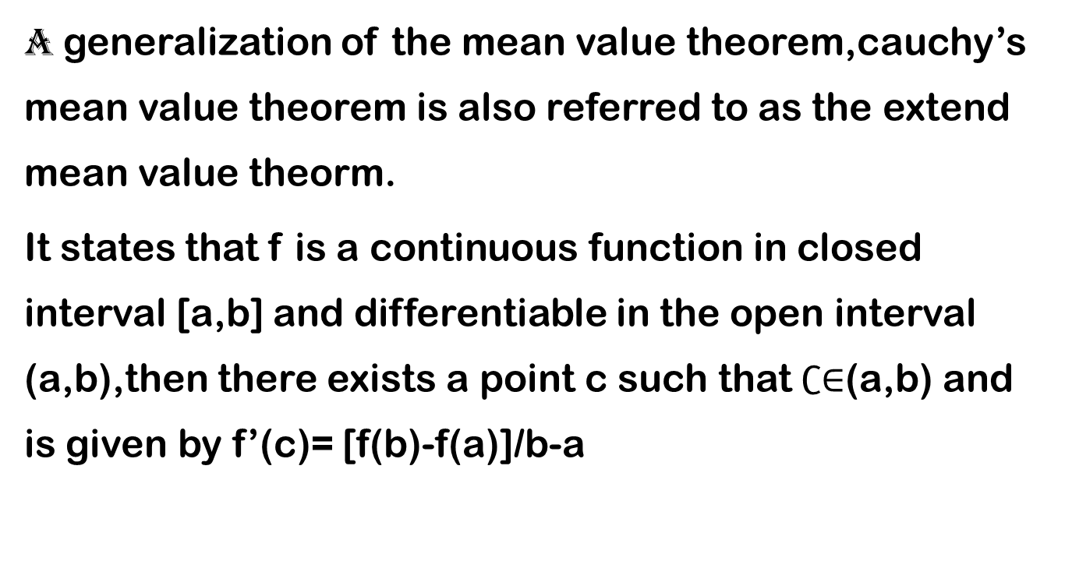
introduction
A generalization of the mean value theorem,cauchy’s mean value theorem is also referred to as the extend mean value theorm.
It states that f is a continuous function in closed interval [a,b] and differentiable in the open interval (a,b),then there exists a point c such that $∁∈$(a,b) and is given by f’(c)= [f(b)-f(a)]/b-a

Slide 3

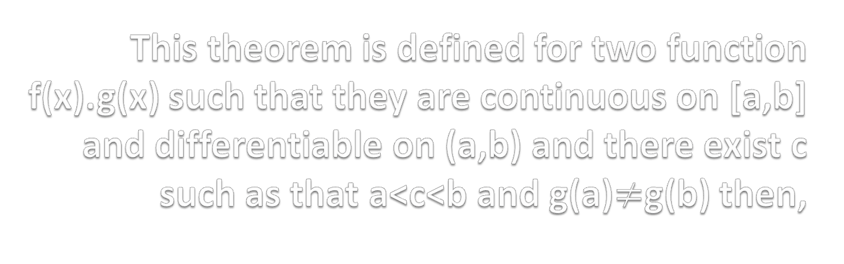
This theorem is defined for two function f(x).g(x) such that they are continuous on [a,b] and differentiable on (a,b) and there exist c such as that a<c<b and g(a)$≠$g(b) then,
$$f\left(b\right)−f\left(a\right)/g\left(b\right)−g\left(a\right)=f′(c)/g′(c)$$

Slide 4
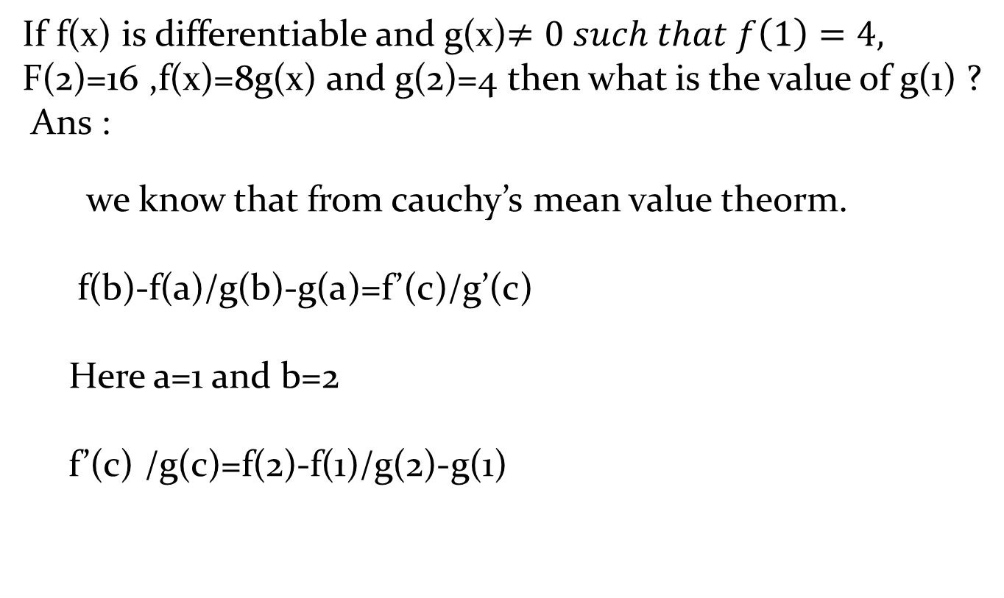
EXAMPLE :
If f(x) is differentiable and g(x)$≠0 such that f\left(1\right)=4,$
F(2)=16 ,f(x)=8g(x) and g(2)=4 then what is the value of g(1) ?
Ans :
we know that from cauchy’s mean value theorm.
f(b)-f(a)/g(b)-g(a)=f’(c)/g’(c)
Here a=1 and b=2
f’(c) /g(c)=f(2)-f(1)/g(2)-g(1)

Slide 5
Now substuting all the given values in the equation
8g’(c)/g’(c)=16-4/4-g(1)
32-8g(1)=12
g(1)=5/2….

Slide 6
Conclusion
The cauchy’s mean value theorm is derived with the help of rolle’s theorm,legrange’s mean value theorm can be deduced from cauchy’s mean value theorm is the relationship between derivatives of two functions and changes in these functions on a finite on a finite interval.

Slide 7
THANK YOU
…………………………………………………………………

